Slide 1

Electric Vehicle Population Data
Niharika Bandlamudi
DA-6813-901
Notes:
Hello today the presentation is about electric vehicle population data

Slide 2
Background:
Electric Vehicle is a vehicle that uses one or more electric motors for propulsion. It can be
powered by a collector system, with electricity from extravehicular sources, or it can be
powered autonomously by a battery (sometimes charged by solar panels, or by converting
fuel to electricity using fuel cells or a generator) EVs include, but are not limited to, road and
rail vehicles, surface and underwater vessels, electric aircraft , and electric spacecraft. For
road vehicles, together with other emerging automotive technologies such as autonomous
driving, connected vehicles, and shared mobility, EVs form a future mobility vision called
Connected, Autonomous, Shared, and Electric (CASE) Mobility.
Notes:
An Electric Vehicle (EV) uses electric motors for propulsion and can be powered by a collector system or a battery, which may be charged by extravehicular sources or renewable sources like solar panels. EVs include road and rail vehicles, vessels, aircraft, and spacecraft. In the automotive sector, EVs are part of the future mobility vision known as Connected, Autonomous, Shared, and Electric (CASE) Mobility, along with autonomous driving, connected vehicles, and shared mobility technologies.

Slide 3
Motivation:
Environmental Impact: The analysis focuses on the environmental benefits of electric vehicles, such as reduced greenhouse gas emissions and decreased reliance on fossil fuels, driving the promotion of alternative fuel vehicles.
Policy and Market Insights: By understanding the factors influencing Clean Alternative Fuel Vehicle (CAFV) eligibility and consumer preferences, policymakers and manufacturers can develop effective incentive programs and tailor offerings to accelerate the adoption of electric vehicles and reduce the environmental impact of traditional vehicles.
Notes:
The analysis highlights electric vehicles' environmental advantages, including reduced greenhouse gas emissions and decreased reliance on fossil fuels. Understanding factors influencing Clean Alternative Fuel Vehicle (CAFV) eligibility and consumer preferences is critical for policymakers and manufacturers to develop effective incentive programs and accelerate EV adoption.

Slide 4
Main Questions:
What is the average electric range of vehicles by make and how does it vary among the top manufacturers?
Are certain EV models preferred over others by consumers?
What is the distribution of EV types (eg: batter electric vehicle, plug-in hybrid electric vehicle) in the dataset and how did it evolve overtime?
Are there demographic patterns that influence EV adoption?
In which Year Electric Vehicles increased?
What are the Top 10 counts of cars per City and per County?
What are the Top 5 vs Bottom 5 Comparison?
Is there any relationship between range anxiety and EV adoption?
Notes:
This are my questions for analysis

Slide 5
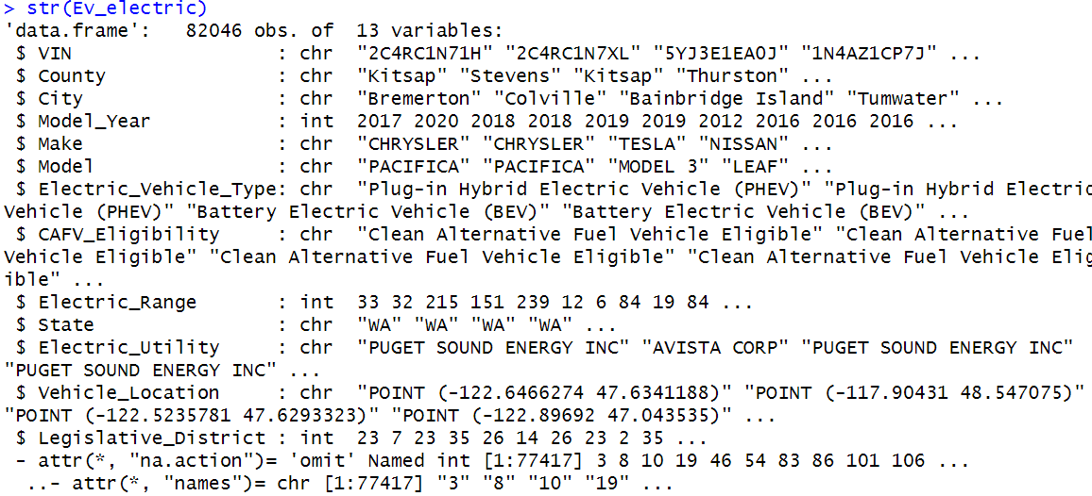
About Data:
There are total 17 variables and 159467 observations in this data. after cleaning there are 82046 observations and 13 variables.
The data was taken from www.kaggle.com and covers the electric vehicles registered in cities of Washington state.
This dataset spans the time frame of 1997 to 2024-feb, a 27-year period.
These variables include both character data, providing a comprehensive overview.
Notes:
This dataset, obtained from Kaggle, covers electric vehicles registered in Washington state cities. Initially this dataset contains 17 variables and 159,467 observations, after cleaning, it consists of 82,046 observations and 13 variables. Spanning 1997 to February 2024, a 27-year timeframe, the dataset offers a comprehensive overview of electric vehicle registration in the area.

Slide 6
Data Cleaning:
Removed few variables which are not needed for analysis and created new data frame called Ev_electric with (VIN, County, City, Model_Year, Make, Model, Electric_Vehicle_Type, CAFV_Eligibility, Electric_Range, State, Electric_Utility and Vehicle_Location)
renaming column names (VIN..1.10. to "VIN“, Clean.Alternative.Fuel.Vehicle..CAFV..Eligibility to CAFV_Eligibility, Model.Year to Model_Year, Electric.Vehicle.Type to Electric_Vehicle_Type etc…)
filtering out rows where certain columns have missing or empty values (NA or "").
Removed one level from CAFV_Eligibility variable because that variable is zero which is affecting my analysis.
Converted 'CAFV_Eligibility' and 'EV_Type_Num' to factors using as.factor().
Notes:
In this data cleaning Unnecessary variables were removed, and a new dataframe, Ev_electric, was created with key columns. Column names were standardized, missing values were filtered out, and 'CAFV_Eligibility' levels were adjusted. 'CAFV_Eligibility' and 'EV_Type_Num' were converted to factors for analysis.

Slide 7
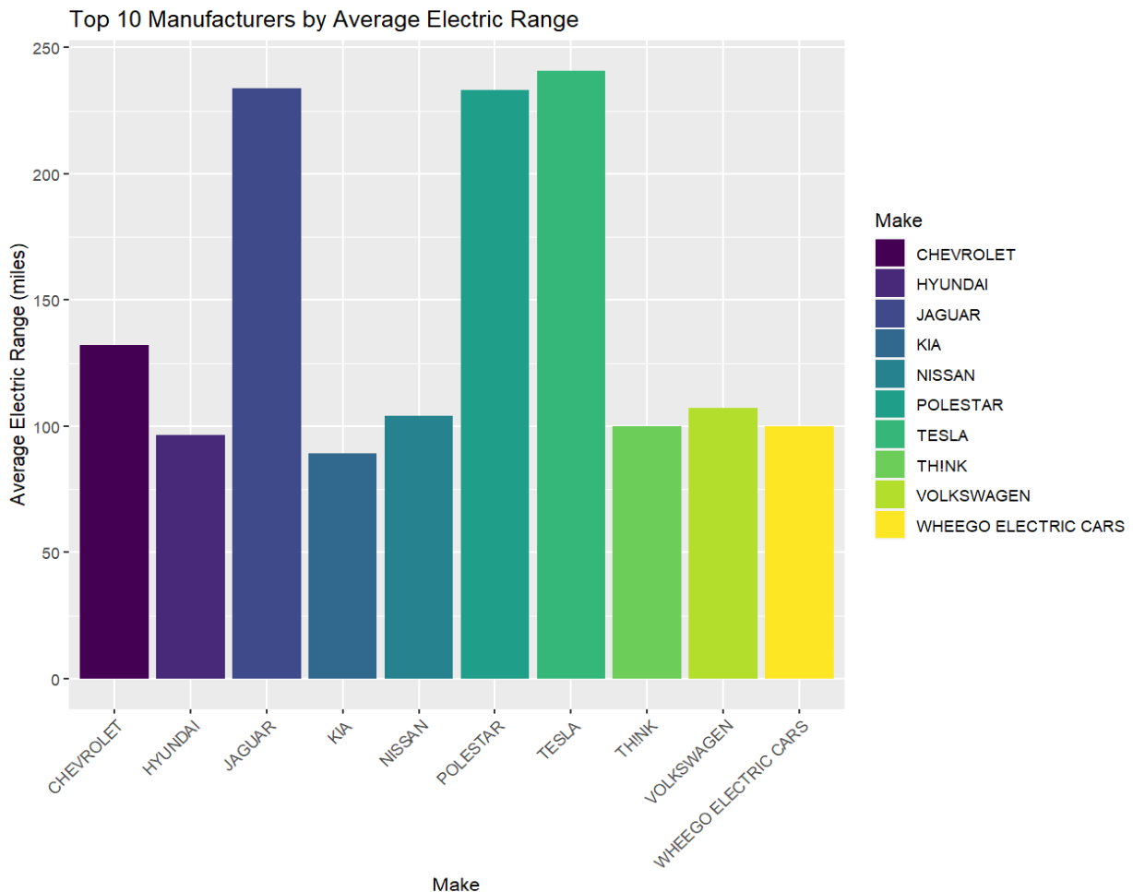
Analysis:
Bar chart showing highest average electric range of vehicles by make and how does it vary among the top 10 manufacturers.
Notes:
Among the top 10 manufacturers, Tesla boasts the highest average electric range, underscoring its leadership in electric vehicle technology. Following Tesla, Polestar demonstrates competitive performance, while Nissan holds a respectable position. Conversely, Chevrolet and Wheego Electric Cars lag behind with the lowest ranges, highlighting the diversity in electric vehicle offerings and Tesla's prominent position in the market.

Slide 8
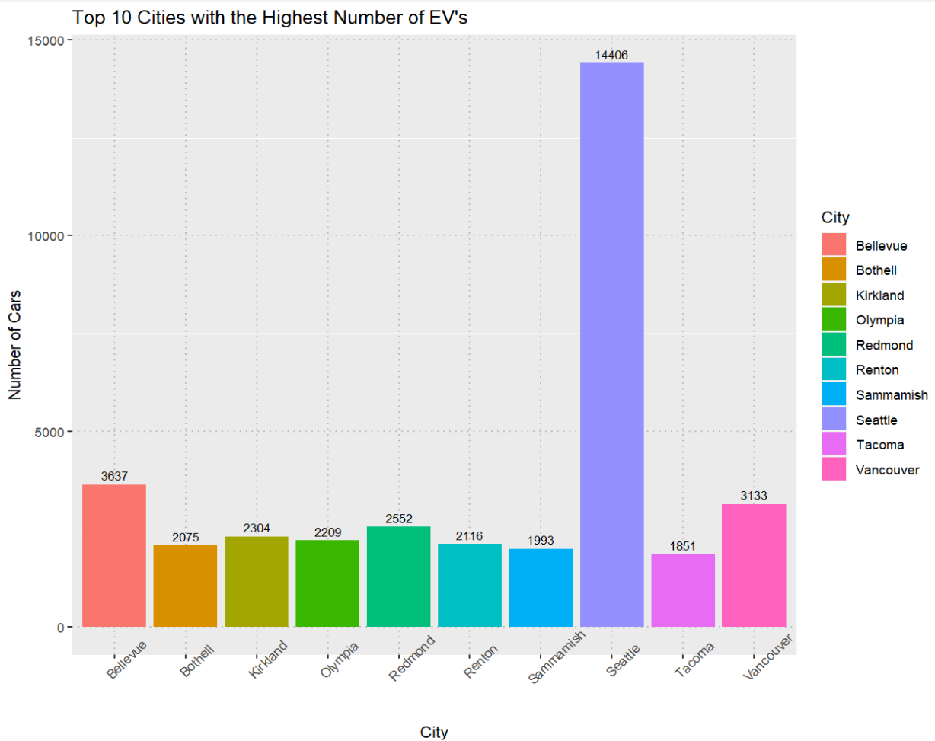
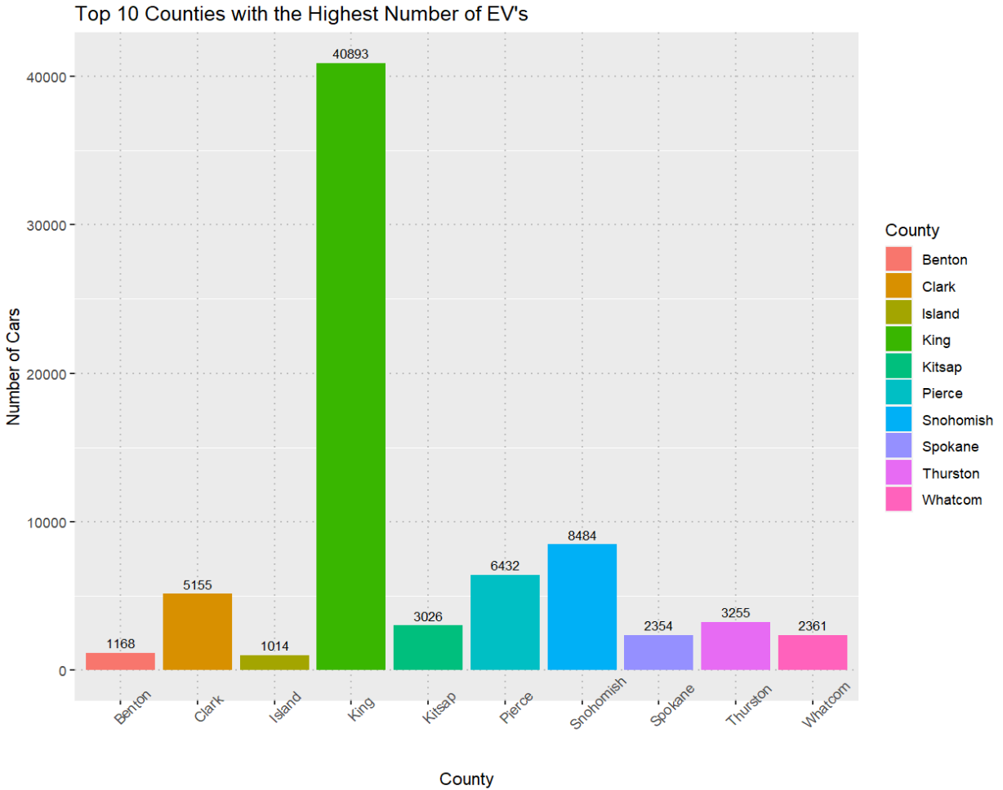
What are the Top 10 counts of cars per City and per County?
King County leads among the top 10 counties with highest number of Electric Vehicles of 40893.
Seattle leads among the top 10 cities with the highest number of electric vehicles of 14406.
Notes:
This graph shows how electric vehicles are distributed among different counties and cities, highlighting a notable disparity. King County, stands out with the highest number of electric vehicles, nearly 40893. and if you see among cities Seattle stands out with the highest number of electric vehicles with 14406 This data underscores the significant difference in electric vehicle adoption between these areas.

Slide 9
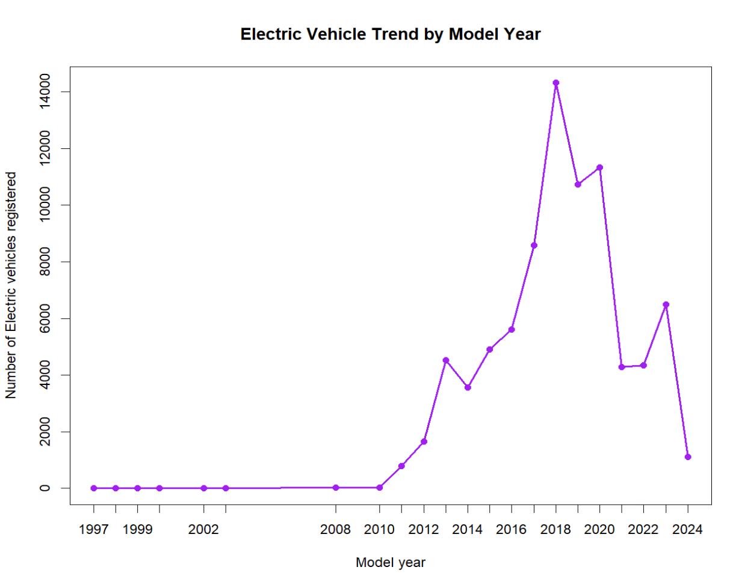
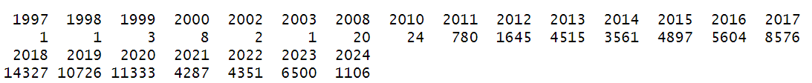
Electric Vehicle Trend by model year using time series analysis.
Notes:
The graph shows a surge in electric vehicle registrations around 2016, peaking in 2018 at about 14,000 registrations before declining. This trend suggests increased interest in electric vehicles during that period, possibly due to factors like government incentives and technological advancements.

Slide 10
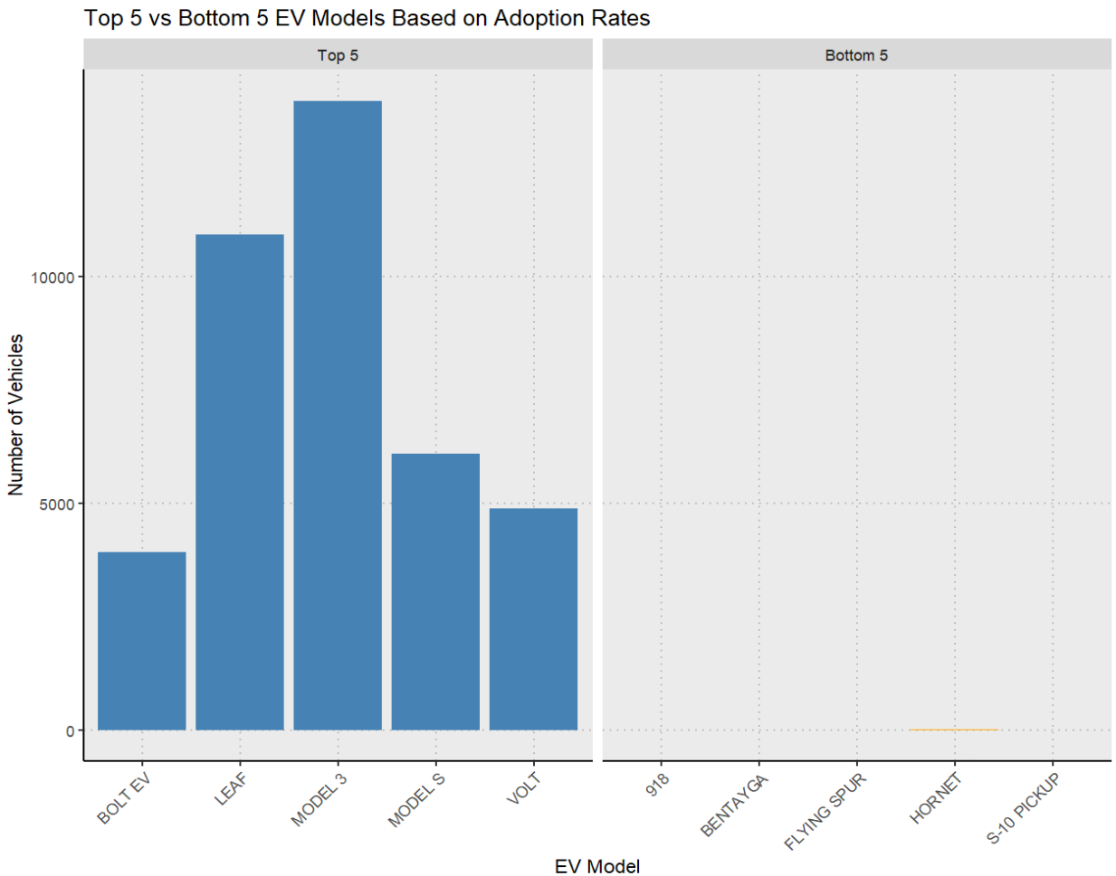
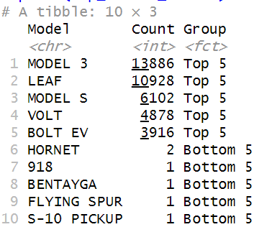
What are the Top 5 vs Bottom 5 Comparison?
Notes:
The bar graph indicates top 5 and bottom 5 number of vehicles based on the model as we see in top 5 models the highest model is Model 3

Slide 11


Are there demographic patterns that influence EV adoption?
Hear I perform both the tests but chi square is not giving appropriate results, so I did fisher’s results.
Also I did regression analysis to check the relation ship between CAFV_Eligibility and Model
> summary(regression_model)
Call:
multinom(formula = CAFV_Eligibility ~ Model, data = Ev_electric)
Coefficients:
Residual Deviance: 9522.797
AIC: 9710.797
Notes:
The regression model, using the multinom function, indicates a significant relationship between CAFV_Eligibility and Model. The model's goodness of fit is supported by a low residual deviance of 9522.797 and a favorable AIC of 9710.797, suggesting a well-fitted and parsimonious model. The Fisher’s Exact Test further strengthens this relationship, showing a very low p-value of 9.999e-05, indicating a statistically significant association between the two variables.

Slide 12
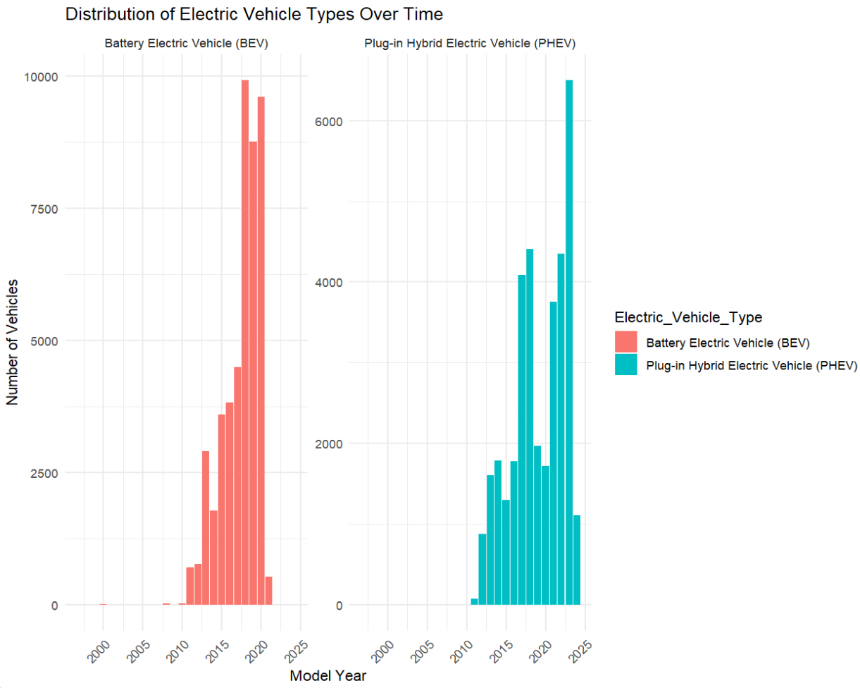
Distribution of EV types (eg: batter electric vehicle, plug-in hybrid electric vehicle) in the dataset.
From this we are checking the historical trends in the registration of Battery Electric Vehicles (BEVs) and Plug-in Hybrid Electric Vehicles (PHEVs) over time.
Notes:
The graph “Distribution of Electric Vehicle Types Over Time” shows trends in Battery Electric Vehicles (BEVs) and Plug-in Hybrid Electric Vehicles (PHEVs) registrations. BEVs were more popular before 2005 but declined afterward, possibly due to battery and infrastructure limitations. PHEVs gained traction around 2010 and sharply increased after 2015, likely influenced by improved battery technology and dual electric-gasoline options' appeal.

Slide 13
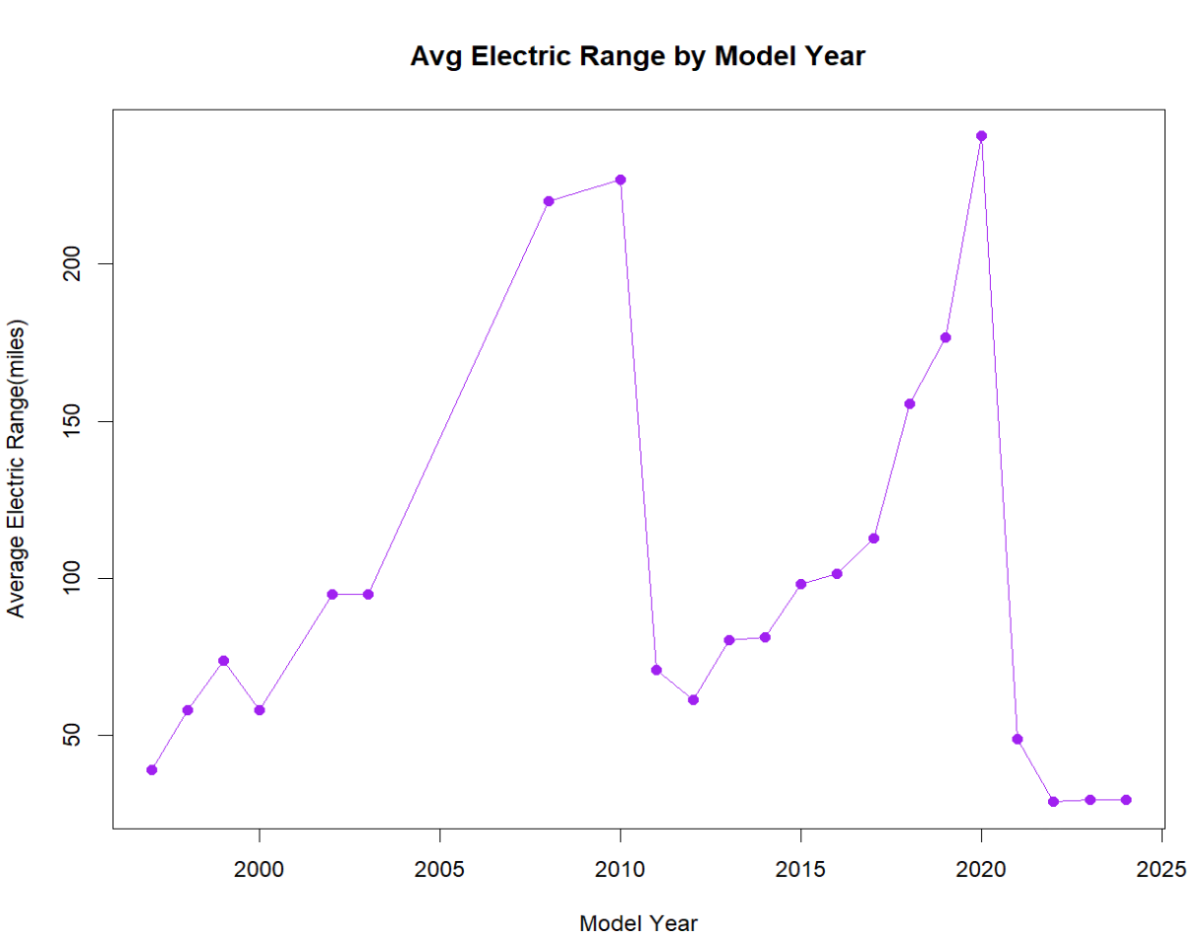
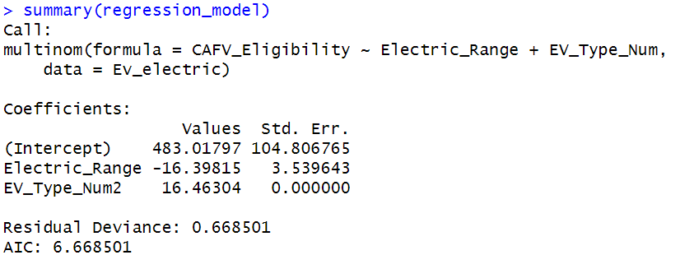
Average Electric Range by model year using time series analysis.
Output:
Notes:
Based on the multinomial logistic regression model, there appears to be a relationship between electric vehicle (EV) adoption and range anxiety. The negative coefficient for Electric_Range suggests that as the range of EVs increases, the likelihood of being in a higher CAFV eligibility category decreases, potentially indicating lower range anxiety. Conversely, the positive coefficient for EV_Type_Num2 suggests that being in category 2 (EV_Type_Num = 2) significantly increases the odds of higher eligibility. This implies that vehicles with longer ranges are more likely to be in the lower eligibility category, possibly due to reduced range anxiety. The model's good fit, indicated by low residual deviance and AIC, supports this interpretation. The graph depicting average electric vehicle range over time further illustrates the technological advancements in EVs, which may contribute to reducing range anxiety and promoting adoption.

Slide 14
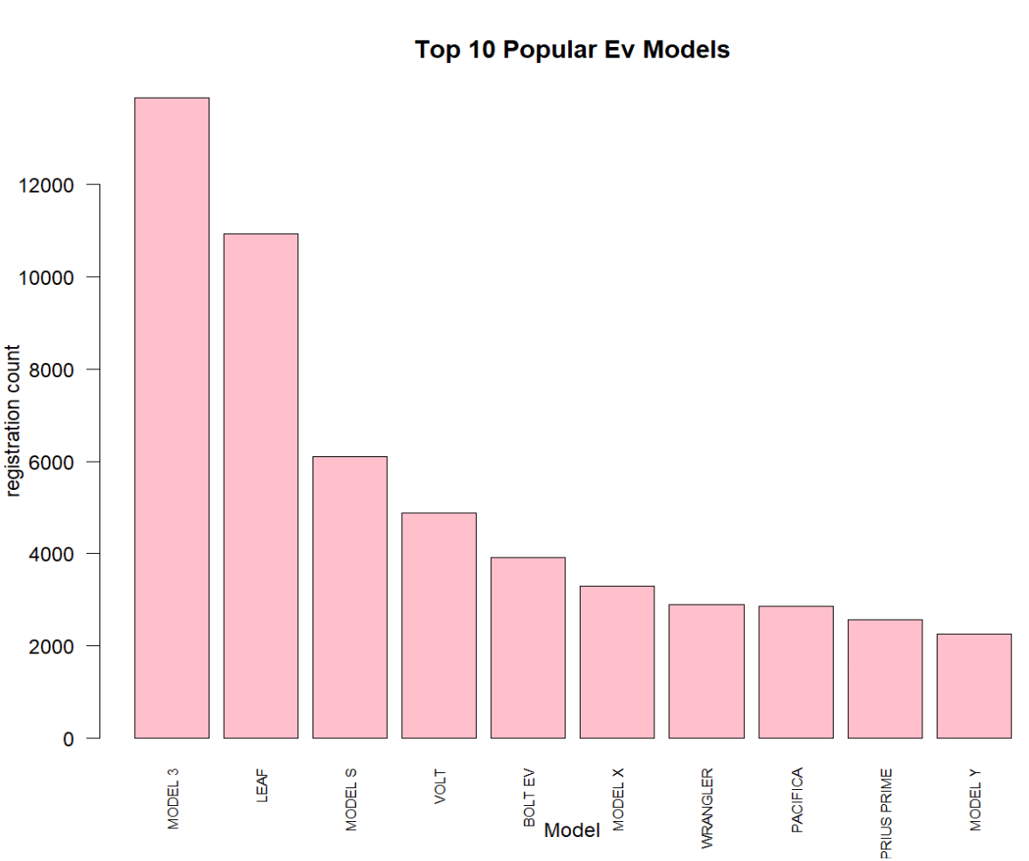
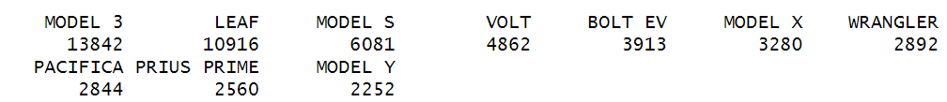
Are certain EV models preferred over others by consumers?
The Model 3 and Model Y are the top two most popular EV models, leading the list based on registration count.
Notes:
The bar graph clearly indicates that the Model 3 is the most popular electric vehicle model, significantly ahead in terms of registrations compared to the other models listed.

Slide 15
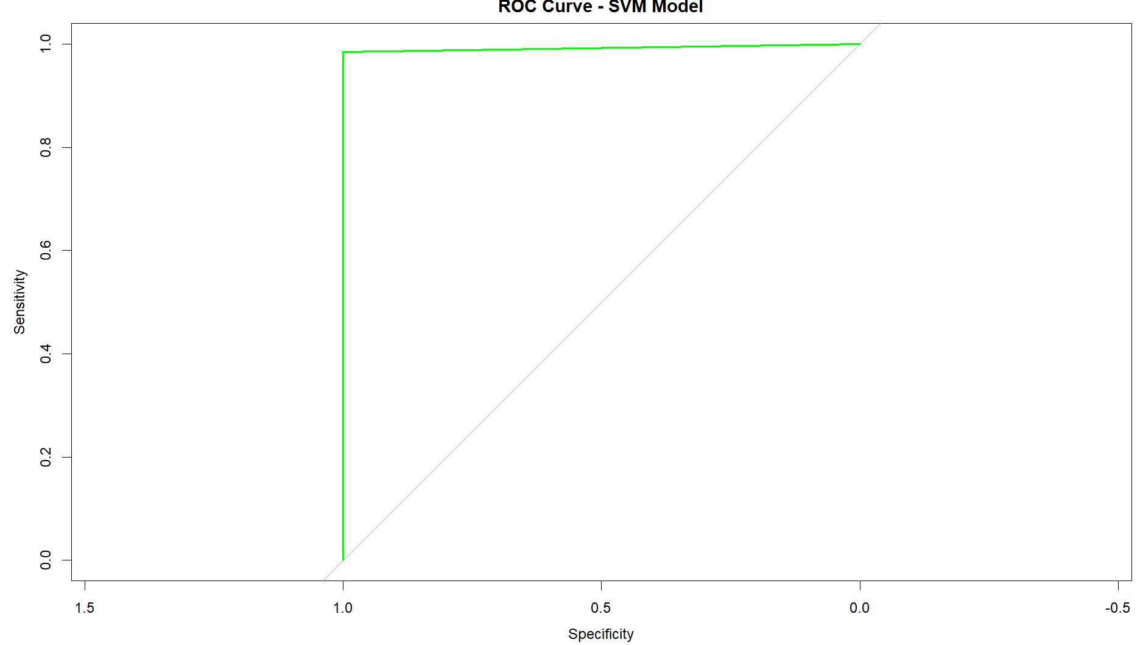
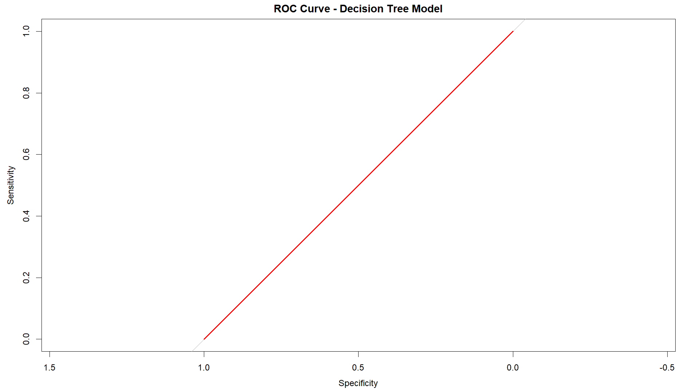
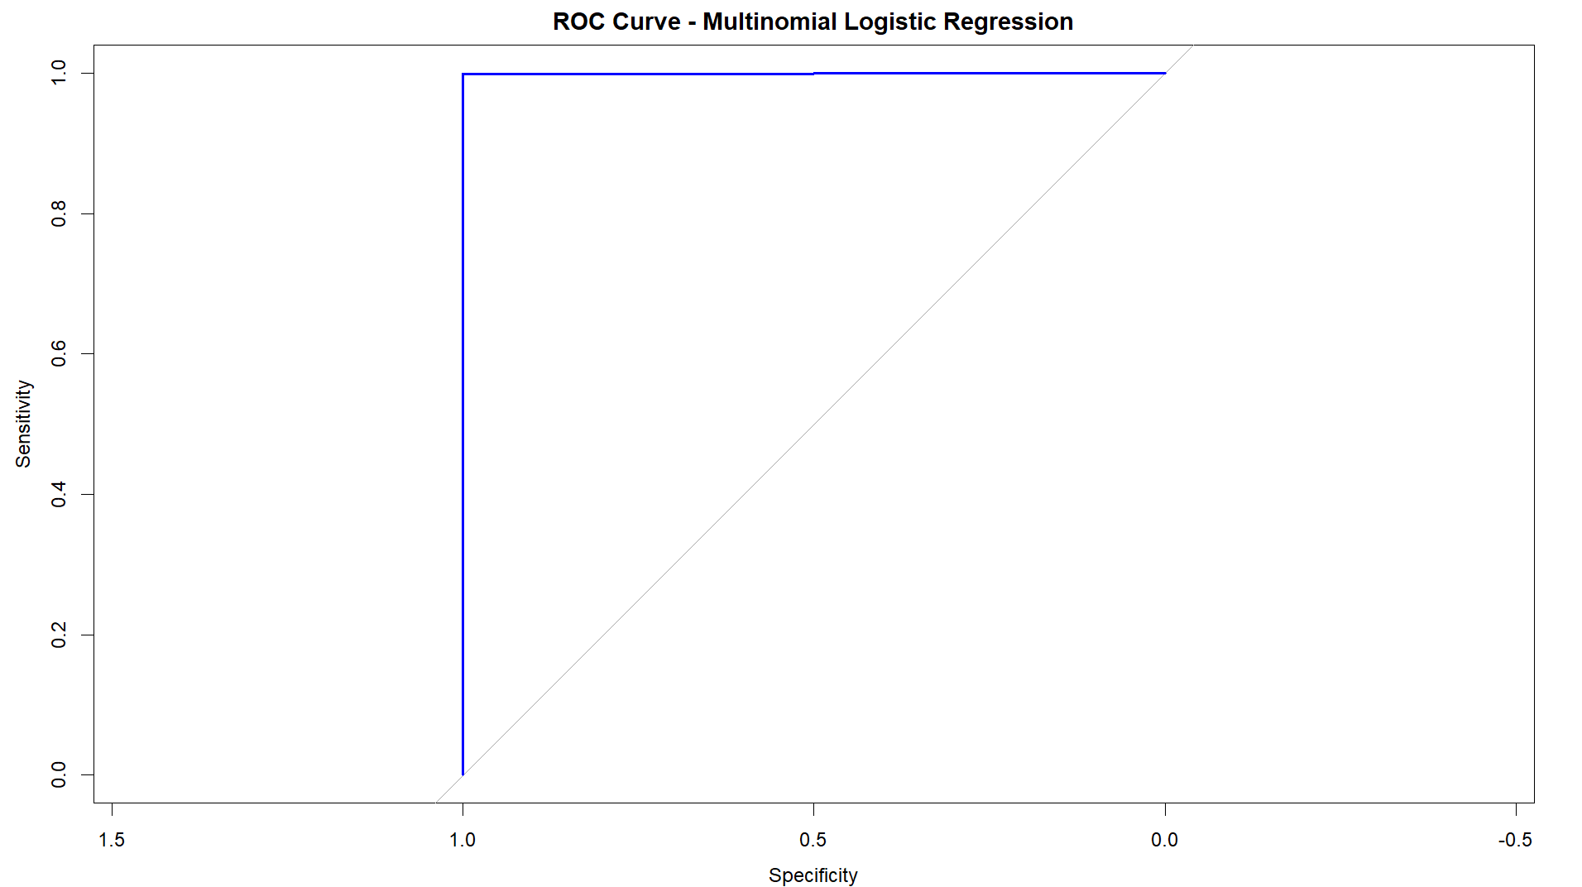
Before balancing
Multinomial Logistic regression:
Accuracy = 0.9998
Precision Score = 0.9997
Recall = 1
f1 score = 0.9998
SVM:
Accuracy = 0.9966
Precision = 0.9956
Recall = 1
F1 score = 0.9978
Decision Tree:
Accuracy = 0.7776
Precision Score = 0.7776
Recall = 1
F1 score = 0.8748
Notes:
Based on these 3 models which are multinomial logestic regression, decision tree and svm The multinomial logistic regression model performs the best based on the provided metrics. It has the highest accuracy, precision score, recall, and F1 score, indicating that it is the most accurate and balanced model among the three.

Slide 16
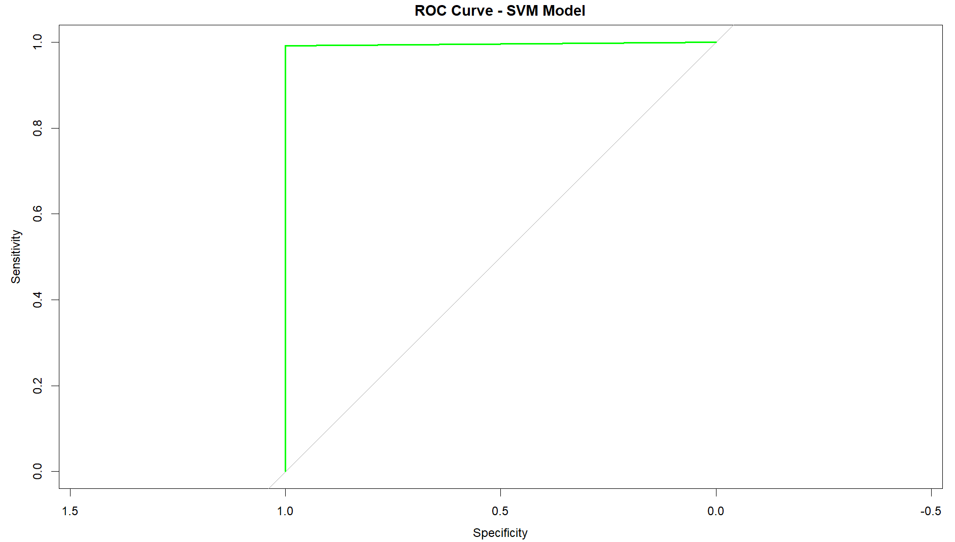
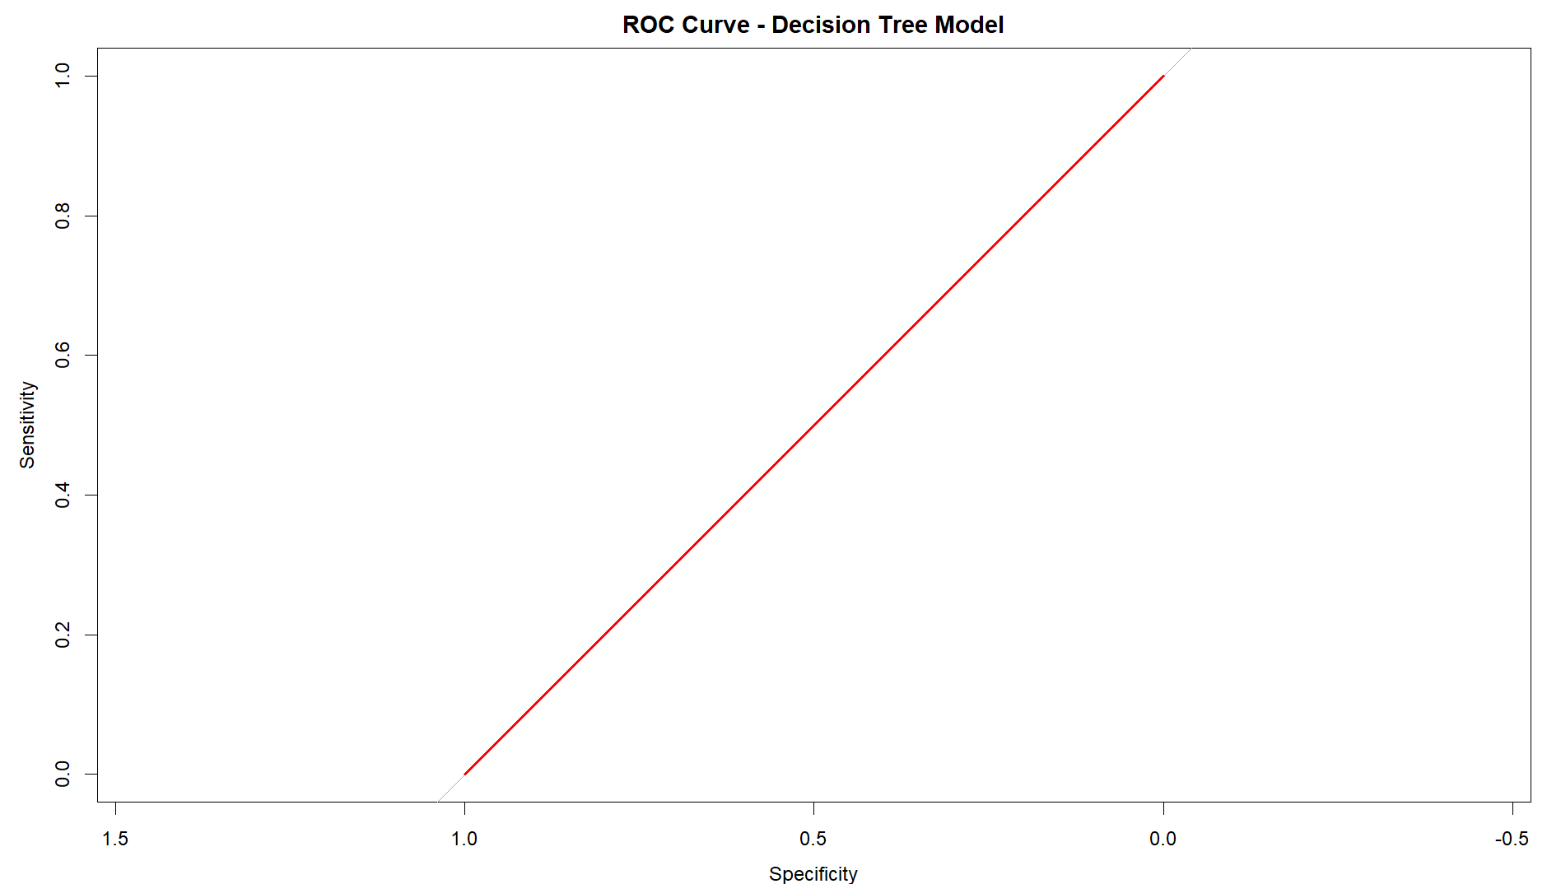
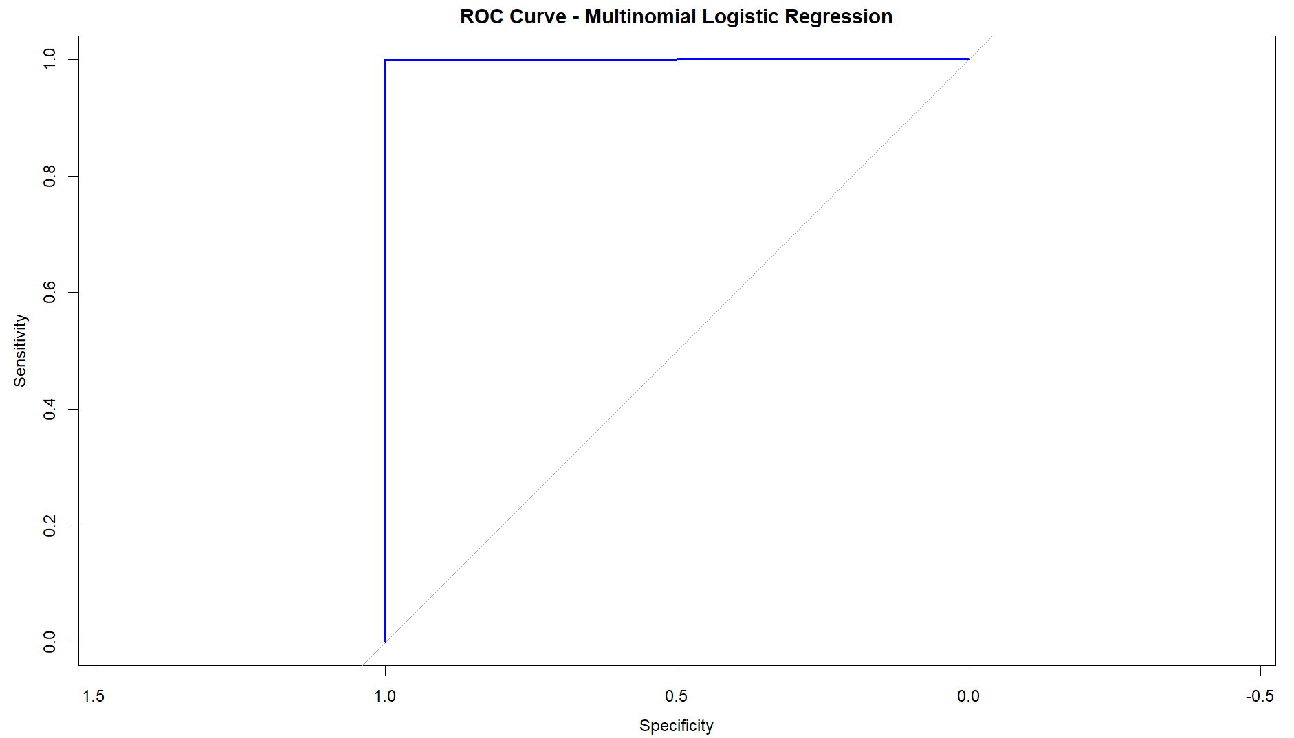
After Balancing
Multinomial logistic regression:
Accuracy = 0.9993
Precision Score= 0.999582
Recall = 0.9995298
F1 score = 0.9995559
SVM:
Accuracy =0.9980
Precision Score=0.9976
Recall = 0.99989
F1 score = 0.99874
Decision Tree:
Accuracy = 0.7776
Precision Score= 0.7776
Recall = 1
F1 score = 0.87489
Notes:
After balancing also multinomial logistic regression model still performs the best among the three models. It has the highest accuracy, precision score, recall, and F1 score, indicating that it is the most accurate and balanced model.

Slide 17

Conclusion:
The analysis highlights the significance of factors like electric range, EV type, and demographic factors in determining CAFV eligibility.
The multinomial logistic regression model emerges as the most accurate in predicting CAFV eligibility, making it a suitable choice for future predictions and policy planning in the electric vehicle industry.
Insights from the analysis provide a comprehensive view of EV adoption trends and consumer preferences over the past 27 years in Washington state.
Variations in average electric range by manufacturer were observed, indicating preferences among consumers for specific ranges.
Certain cities and counties showed higher adoption rates, suggesting localized factors influencing EV uptake.
Specific years were identified as pivotal for EV adoption increases, indicating potential drivers of adoption.
Preferences for specific EV models were evident, which can inform manufacturers and policymakers on product strategies and incentives.
These insights can guide policymakers and stakeholders in developing strategies to promote sustainable transportation and incentivize EV adoption.
Notes:
The analysis of electric vehicle data in Washington state highlights the importance of factors like electric range and demographic data in determining CAFV eligibility. The multinomial logistic regression model is the most accurate for predicting eligibility, making it valuable for future predictions and policy planning. Insights into EV adoption trends and consumer preferences can also guide strategies to promote sustainable transportation.

Slide 18


